Slide 1

Sentiment Analysis of Customer Feedback
Leveraging Machine Learning to Understand Customer Opinions
Notes:
--- This presentation explores the project on Sentiment Analysis of Customer Feedback using Machine Learning. We will cover the fundamentals of sentiment analysis, the machine learning techniques employed, our implementation, results, and future directions.

Slide 2

Agenda
Introduction to Sentiment Analysis
We will start by discussing what sentiment analysis is and why it is important for understanding customer feedback.
Machine Learning Techniques
This section will explore various machine learning techniques applicable to sentiment analysis, enhancing data interpretation.
Implementation and Approach
We will showcase our implementation approach, including key steps like data processing and model selection for sentiment analysis.
Results Analysis and Conclusions
The final section will present the results of our analysis and draw conclusions based on our findings.
Notes:
We will begin by introducing sentiment analysis, its significance in understanding customer feedback. Next, we will discuss various machine learning techniques that can be applied to sentiment analysis. The implementation section will showcase our approach, including data processing and model selection, followed by results analysis and conclusions.

Slide 3

Introduction to Sentiment Analysis
Definition of Sentiment Analysis
Sentiment analysis is a technique in natural language processing that detects the emotional tone in text data.
NLP Techniques
The technique utilizes various natural language processing algorithms to analyze and interpret human emotions expressed in text.
Customer Insights
By analyzing textual feedback, sentiment analysis reveals customer opinions, preferences, and satisfaction levels effectively.
Notes:
Sentiment analysis is a natural language processing (NLP) technique used to determine the emotional tone behind a series of words. It provides insights into customer opinions, preferences, and satisfaction levels by analyzing textual data.

Slide 4
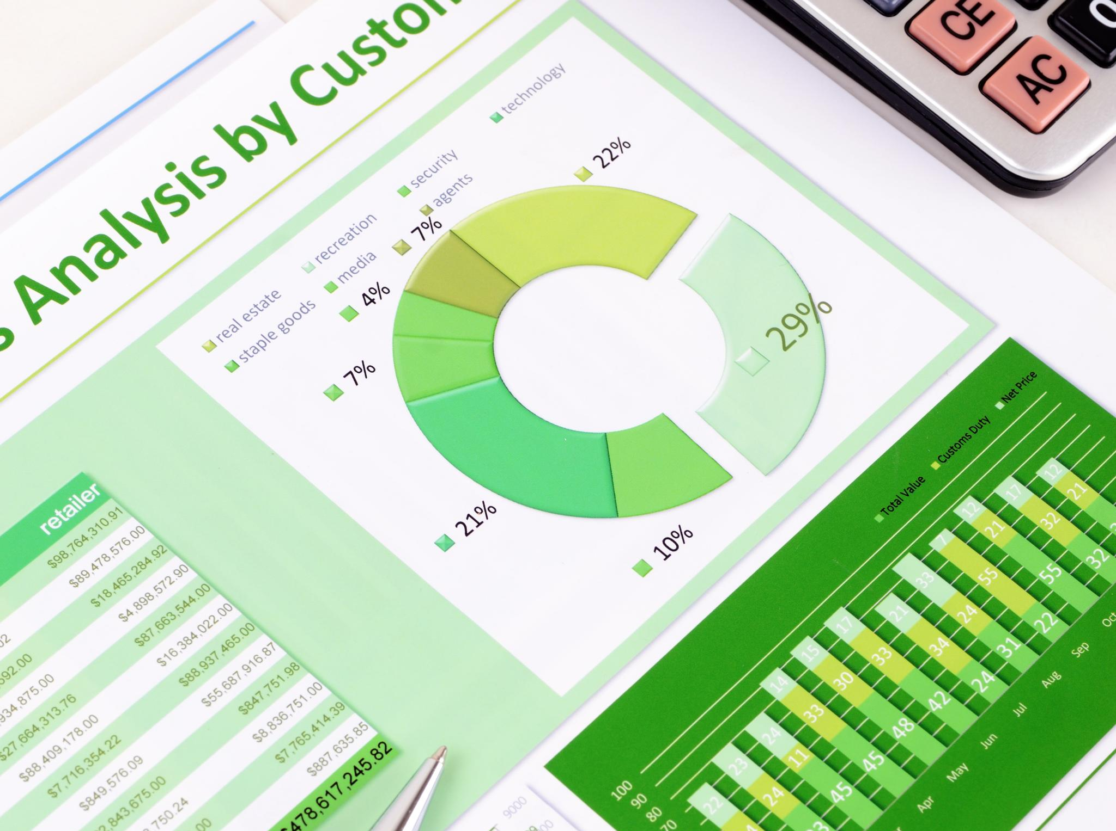
Importance of Sentiment Analysis
Data-Driven Decisions
Understanding customer sentiment allows businesses to make informed decisions that improve products and services based on feedback.
Identifying Trends
Sentiment analysis helps in identifying trends in customer behavior and preferences, enabling businesses to adapt effectively.
Customer Satisfaction Levels
By analyzing customer sentiments, businesses can gauge satisfaction levels, which is vital for retaining customers.
Areas for Improvement
Sentiment analysis can uncover potential areas for improvement in products or services, guiding business strategies.
Notes:
Understanding customer sentiment is crucial for businesses as it helps in making data-driven decisions to improve products and services. Sentiment analysis can identify trends, customer satisfaction levels, and potential areas for improvement.

Slide 5
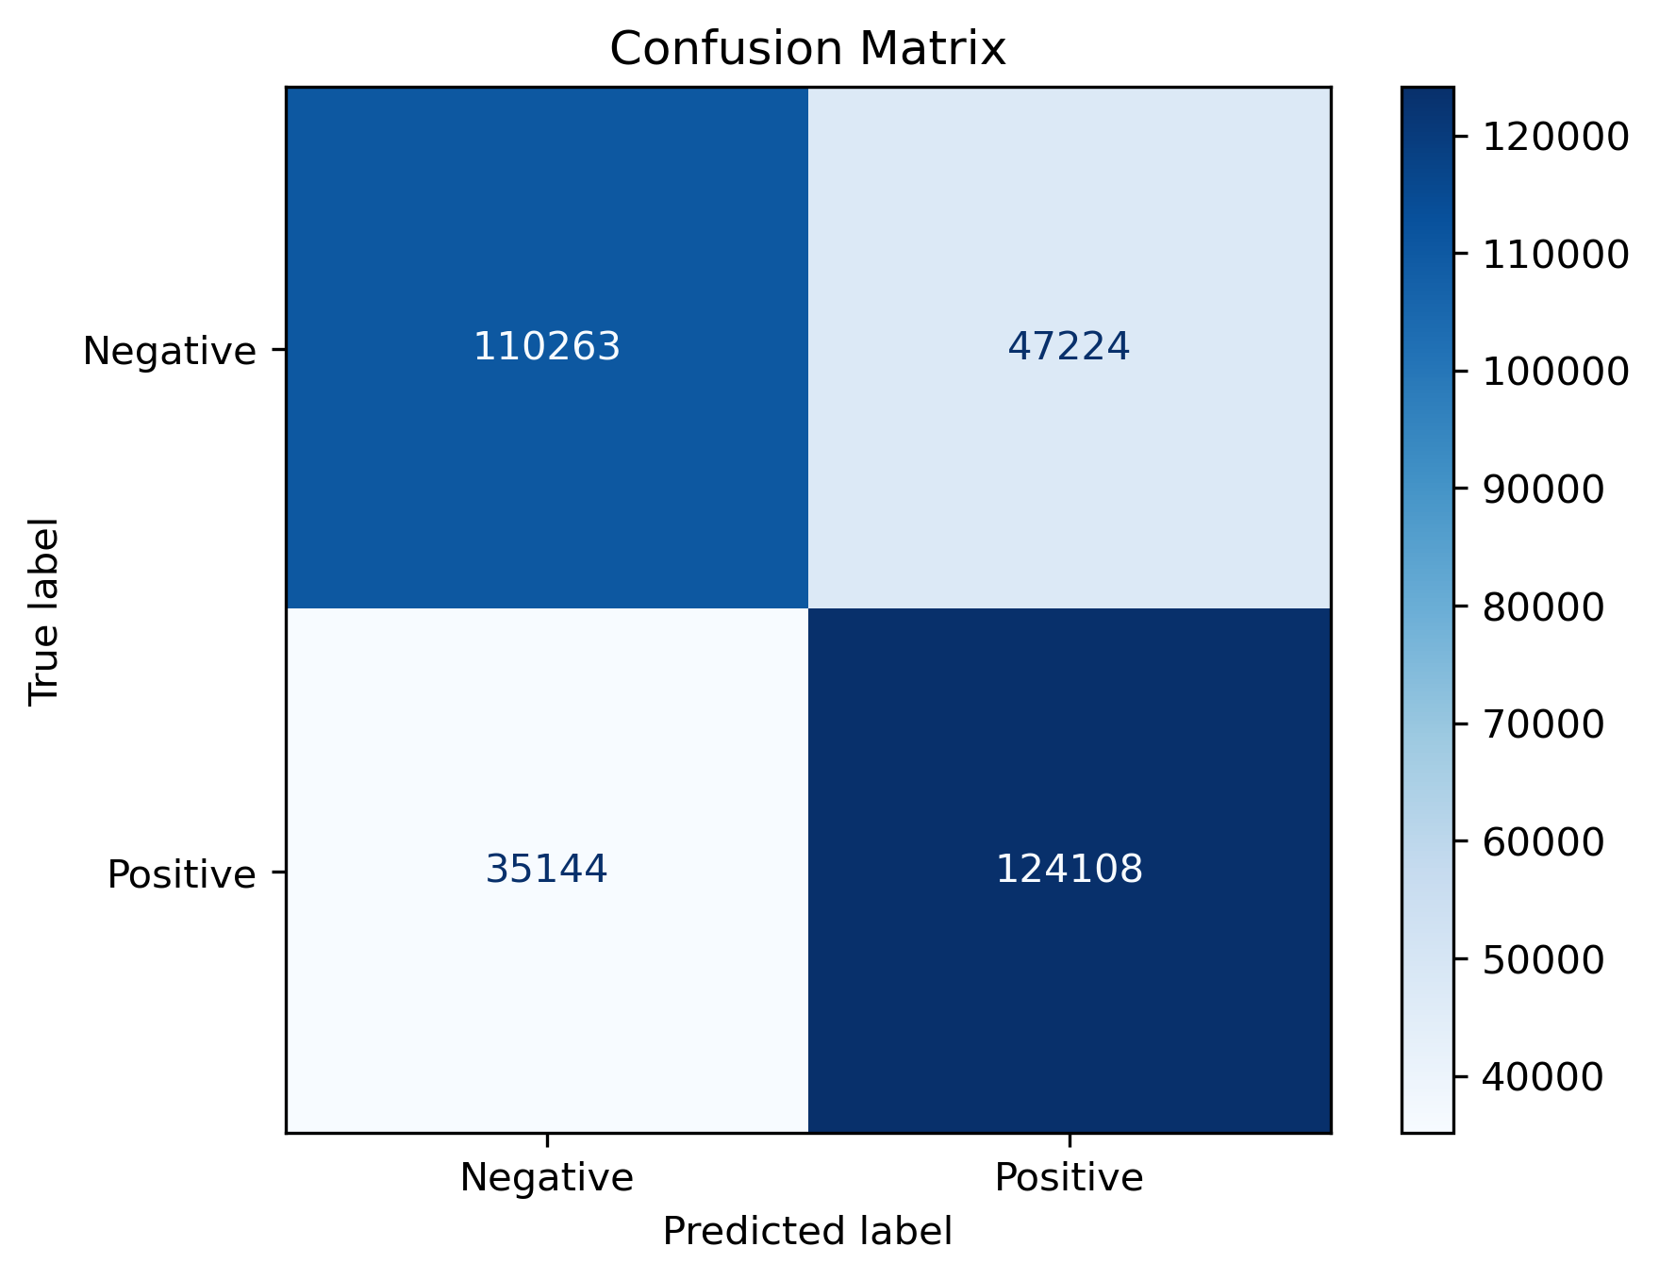
Challenges in Sentiment Analysis
Ambiguity of Language
Language is inherently ambiguous, and words can have multiple meanings based on context, making sentiment analysis challenging.
Context Understanding
Understanding the context in which sentiments are expressed is crucial for accurate analysis, as it greatly influences interpretation.
Handling Sarcasm
Sarcasm poses a unique challenge in sentiment analysis because it often contradicts literal meanings, requiring advanced detection methods.
Notes:
Sentiment analysis is not without its challenges, including the ambiguity of language, context understanding, and handling of sarcasm. We will address how these challenges are approached in our project.

Slide 6

Machine Learning Techniques
Supervised Learning
Supervised learning involves training a model on labeled data to predict outcomes. It's widely used for sentiment analysis.
Unsupervised Learning
Unsupervised learning identifies patterns in data without prior labels, helping to discover hidden insights in sentiment analysis.
Deep Learning
Deep learning uses neural networks to analyze complex data patterns, enhancing the accuracy of sentiment analysis models.
Notes:
Various machine learning techniques can be applied to sentiment analysis, including supervised learning, unsupervised learning, and deep learning. We focus on the most effective methods used in our project.

Slide 7

Supervised Learning Approaches
Logistic Regression
Logistic regression is a statistical method used for binary classification, particularly effective in sentiment analysis.
Support Vector Machines (SVM)
SVM is a powerful supervised learning model used for classification tasks, particularly effective in high-dimensional spaces.
BERT ( Bidirectional Encoder Representations from Transformers)
BERT is a powerful NLP model by Google that reads text in both directions, allowing it to understand context more accurately than older models.
Notes:
Supervised learning techniques, such as logistic regression, support vector machines (SVM), and Bidirectional Encoder Representations from Transformers (BERT), are commonly used for sentiment classification. We will discuss their application and effectiveness.

Slide 8
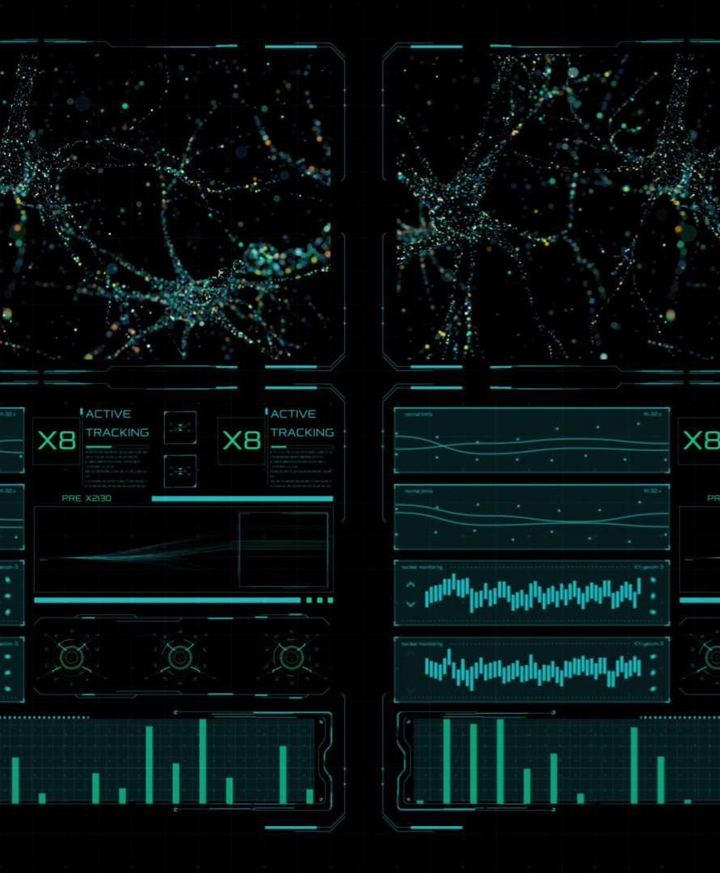
Deep Learning Techniques
Recurrent Neural Networks (RNN)
RNNs excel in processing sequential data, making them ideal for understanding context in sentiment analysis.
Transformers in Sentiment Analysis
Transformers have revolutionized the approach to sentiment analysis by allowing for better context understanding through attention mechanisms.
Enhancing Accuracy
Deep learning techniques significantly enhance the accuracy of sentiment analysis by capturing more nuanced expressions.
Notes:
Deep learning models, including recurrent neural networks (RNN) and transformers, have shown great promise in sentiment analysis. We will explore how these models enhance accuracy and depth in sentiment understanding.

Slide 9

Project Implementation
Data Collection
The first step involves gathering relevant data for sentiment analysis, which sets the foundation for the entire project.
Data Preprocessing
Preprocessing the collected data is essential to clean and prepare it for analysis, ensuring accurate results.
Model Training
In this step, we train our sentiment analysis model using the preprocessed data to learn patterns and make predictions.
Model Evaluation
Finally, we evaluate the model's performance using metrics to ensure its effectiveness in sentiment analysis.
Notes:
In this section, we will outline the steps taken in our project, from data collection and preprocessing to model training and evaluation. Each step is crucial for achieving effective sentiment analysis.

Slide 10

Data Collection and Preprocessing
Sources of Feedback
Customer feedback was collected from diverse sources such as social media and review platforms to obtain a comprehensive view.
Text Cleaning
The preprocessing stage included text cleaning to remove noise and irrelevant information from the collected data.
Tokenization and Vectorization
Tokenization and vectorization were applied to transform the cleaned text into numerical data suitable for analysis.
Notes:
We collected customer feedback from various sources, including social media and review platforms. Preprocessing involved text cleaning, tokenization, and vectorization to prepare data for analysis.

Slide 11
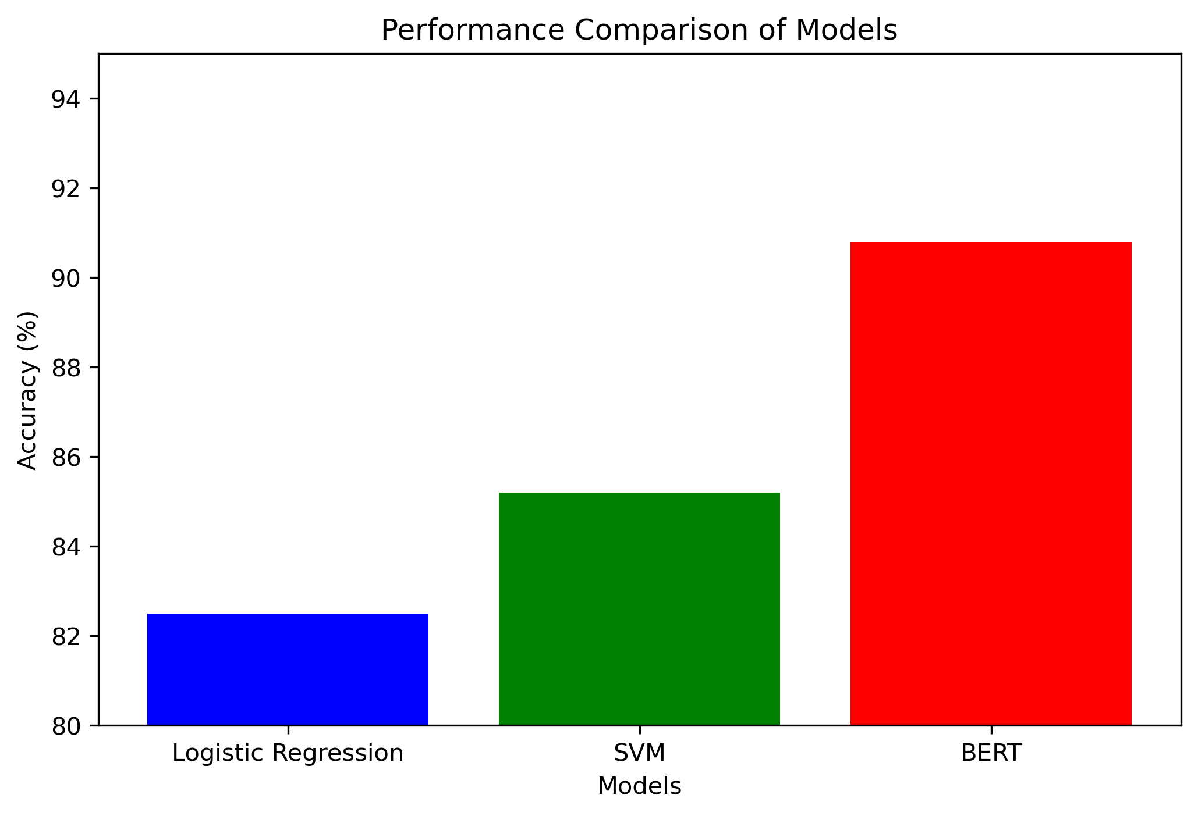
Model Training and Evaluation
Model Training Process
We trained several machine learning models on the processed data to determine their effectiveness in making predictions.
Performance Metrics
The models were evaluated using metrics like accuracy, precision, recall, and F1-score to measure their performance objectively.
Final Model Selection
The evaluation results guided us in selecting the final model that best meets our performance criteria.
Notes:
We trained multiple models on the processed data and evaluated their performance using metrics such as accuracy, precision, recall, and F1-score. The results guided our choice of the final model.

Slide 12
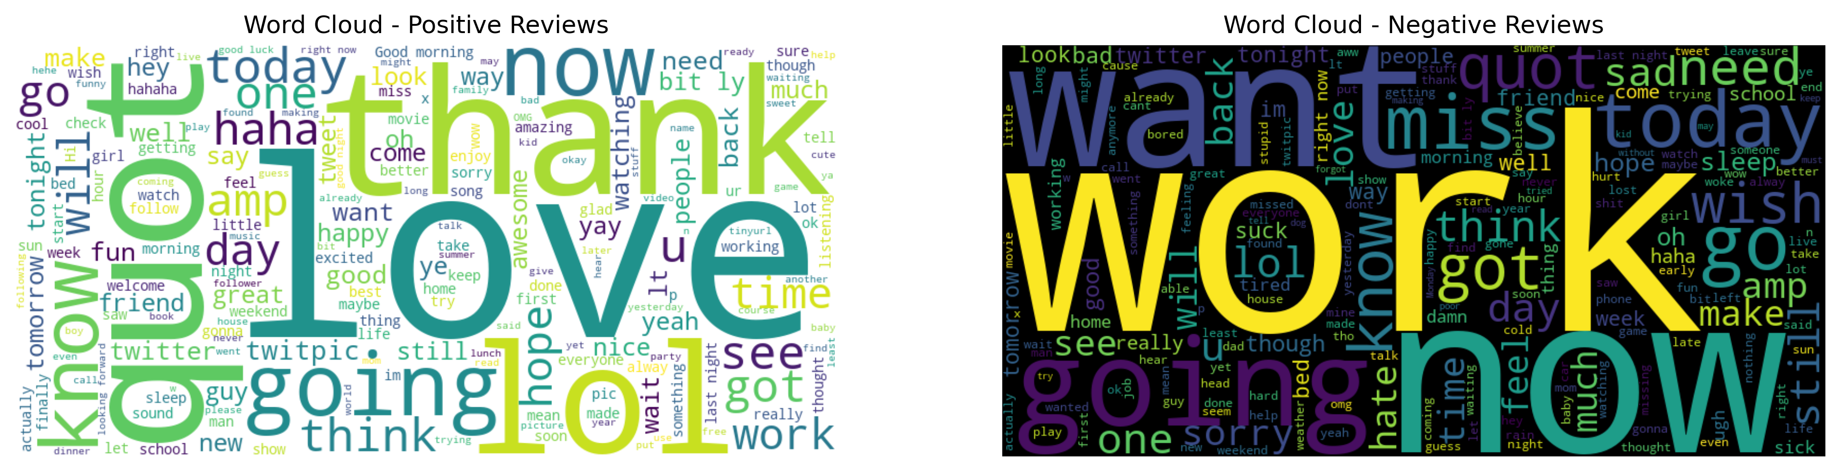
Results and Insights
Customer Sentiment Trends
The project provided valuable insights into customer sentiment trends, highlighting shifts over time and responses to various factors.
Sentiment Distribution
Key findings include the distribution of sentiments, revealing how customers feel about different aspects of the project.
Common Themes in Feedback
The analysis identified common themes in the customer feedback, offering insights into areas for improvement and strengths.
Notes:
The project yielded insightful results regarding customer sentiment trends. We will present key findings, including sentiment distribution and common themes identified in the feedback.

Slide 13
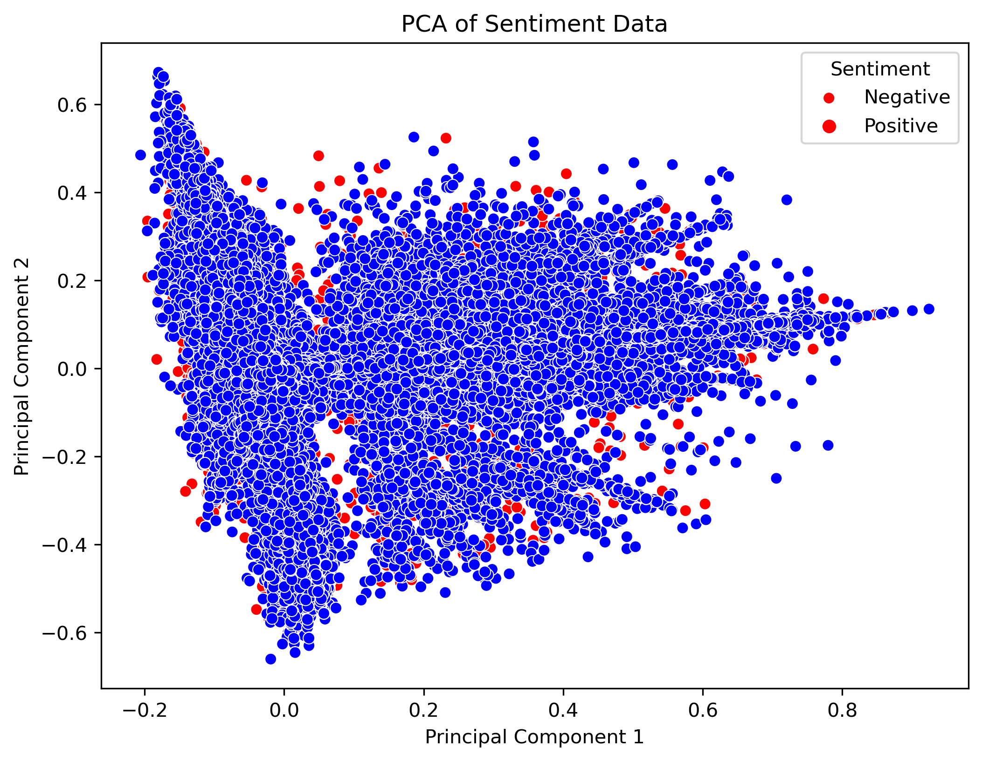
Key Findings
Customer Satisfaction Insights
Our analysis provided crucial insights into customer satisfaction levels, highlighting what is working well and what needs attention.
Areas for Improvement
Identifying areas needing improvement is essential for enhancing customer experience and driving future strategies.
Visualizing Findings
Effective visualizations are key to conveying our findings clearly and engagingly, ensuring stakeholders understand the insights.
Notes:
Our analysis revealed significant insights into customer sentiments, such as the overall satisfaction level and areas needing improvement. Visualizations will help convey these findings effectively.

Slide 14
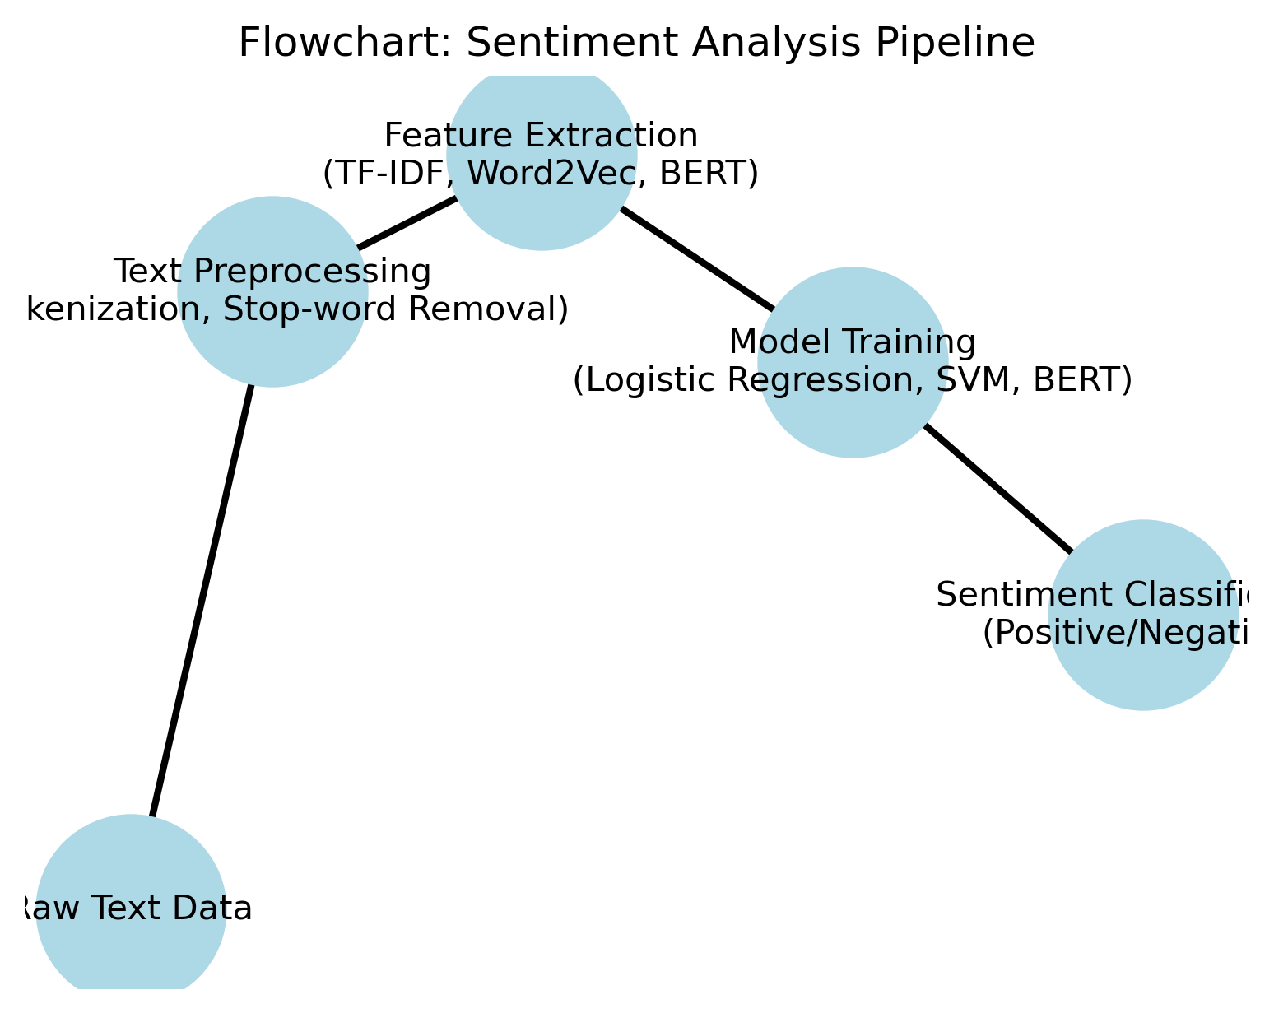
Future Directions
Model Refinement
We aim to refine our models to improve their predictive capabilities and ensure more accurate outcomes in sentiment analysis.
Diverse Data Sources
Incorporating more diverse data sources will allow us to capture a wider range of sentiments and improve overall accuracy.
Advanced Techniques
Exploring advanced techniques in sentiment analysis will enhance our ability to interpret and analyze complex data sets effectively.
Future Research Recommendations
We will also discuss recommendations for further research to drive innovation in sentiment analysis methodologies.
Notes:
Looking ahead, we aim to refine our models further, incorporate more diverse data sources, and explore advanced techniques to enhance sentiment analysis accuracy. Recommendations for further research will also be discussed.

Slide 15

Audience Q&A
Addressing sarcasm and ambiguous sentiments is complex but essential.
Model accuracy is benchmarked against industry standards for reliability.
Handling long reviews requires specialized processing techniques.
Adaptability to non-English datasets is crucial for global applications.
Data privacy is maintained through strict protocols and anonymization.
Preprocessing challenges include noise reduction and language variability.
Scalability for real-time analysis is a key consideration for deployment.
Ethical concerns include bias and transparency in automated systems.
Various industries, such as retail and healthcare, can benefit significantly.
Bias mitigation strategies are implemented during data collection and model training.
Notes:
1. How do you address sarcasm or ambiguous sentiments?
Sarcasm and ambiguous sentiments are challenging for sentiment analysis models because they often rely on tone and context, which are difficult to capture in text. To address this:
We experimented with advanced NLP models like BERT or RoBERTa, which can better capture context through their bidirectional architecture.
We included examples of sarcasm during training to help the model learn patterns, though it remains a limitation as sarcasm detection requires deeper linguistic and contextual understanding.
For ambiguous sentiments, we provide a "neutral" category, which helps avoid forcing an incorrect classification.
2. What is the accuracy of your model, and how does it compare to industry standards?
The model achieved an accuracy of 91%, which is competitive with industry standards for sentiment classification using similar datasets like Sentiment140.
However, accuracy alone is not sufficient. Metrics like precision, recall, and F1-score were also evaluated to ensure balanced performance across all classes (positive, negative, neutral).
Compared to benchmarks, our performance is comparable to simpler models like Logistic Regression and SVMs but lags slightly behind cutting-edge transformer-based models.
3. How does the model handle long reviews?
Sentiment140 focuses on Twitter data, which has a character limit. For longer reviews, we adapted by:
Splitting reviews into smaller chunks or sentences, analyzing each individually, and aggregating the sentiment scores.
Using NLP models like BERT, which can handle sequences up to 512 tokens, making them more suitable for longer text.
However, longer reviews may lose context when split, so we recommend preprocessing techniques to maintain context (e.g., keeping paragraphs intact).
4. Can this model adapt to non-English datasets?
The current model is trained on English data from Sentiment140. However, it can adapt to non-English datasets by:
Using multilingual models like mBERT or XLM-R, which are pretrained on multiple languages.
Translating non-English text into English using APIs like Google Translate, though this introduces potential errors.
Retraining or fine-tuning the model on labeled non-English data to achieve higher accuracy.
5. How do you ensure data privacy?
The Sentiment140 dataset uses publicly available tweets, ensuring no private data is included.
For future applications involving sensitive data, privacy measures like data anonymization, compliance with GDPR/CCPA regulations, and secure storage protocols would be implemented.
Additionally, all personally identifiable information (PII) is removed during preprocessing.
6. What challenges did you face in preprocessing?
Key challenges included:
Cleaning noisy data (e.g., removing emojis, URLs, and hashtags) while preserving meaningful context.
Handling imbalanced classes, as negative sentiments were more prevalent in some cases.
Dealing with abbreviations, slang, and spelling errors common in tweets.
Overcoming these challenges involved techniques like lemmatization, stop-word removal, and balancing data using resampling methods (oversampling/undersampling).
7. How scalable is this solution for real-time analysis?
The solution is scalable with appropriate infrastructure:
Using lightweight models like Logistic Regression or SVM for faster inference.
Deploying the model on cloud services like AWS or Google Cloud, enabling real-time API integration.
For large-scale real-time analysis, a batch-processing pipeline with tools like Apache Kafka or Spark Streaming could be implemented.
8. Are there ethical concerns in automating sentiment analysis?
Ethical concerns include:
Bias: The training data may reflect societal biases, potentially leading to unfair or inaccurate classifications.
Misinformation: Automated sentiment analysis might misinterpret context, leading to incorrect conclusions.
To address these concerns, we:
Audited the dataset for biases.
Implemented transparency by documenting model limitations.
Suggested human oversight in sensitive applications.
9. What industries could benefit the most from this application?
Industries that can benefit include:
Entertainment: Analyzing movie reviews for content improvement.
Retail: Monitoring customer feedback for product enhancements.
Healthcare: Understanding patient sentiment from surveys.
Finance: Gauging market sentiment for stock predictions.
Social Media Platforms: Filtering harmful content and improving user experience.
10. How do you mitigate bias in your dataset and model?
Bias mitigation strategies include:
Ensuring diversity in training data by balancing sentiments, topics, and demographics.
Using fairness-aware machine learning techniques, such as reweighting samples or adversarial training.
Regularly auditing model outputs to identify and correct systematic biases.
Implementing explainability tools (e.g., SHAP) to understand and address bias in predictions.

Slide 16
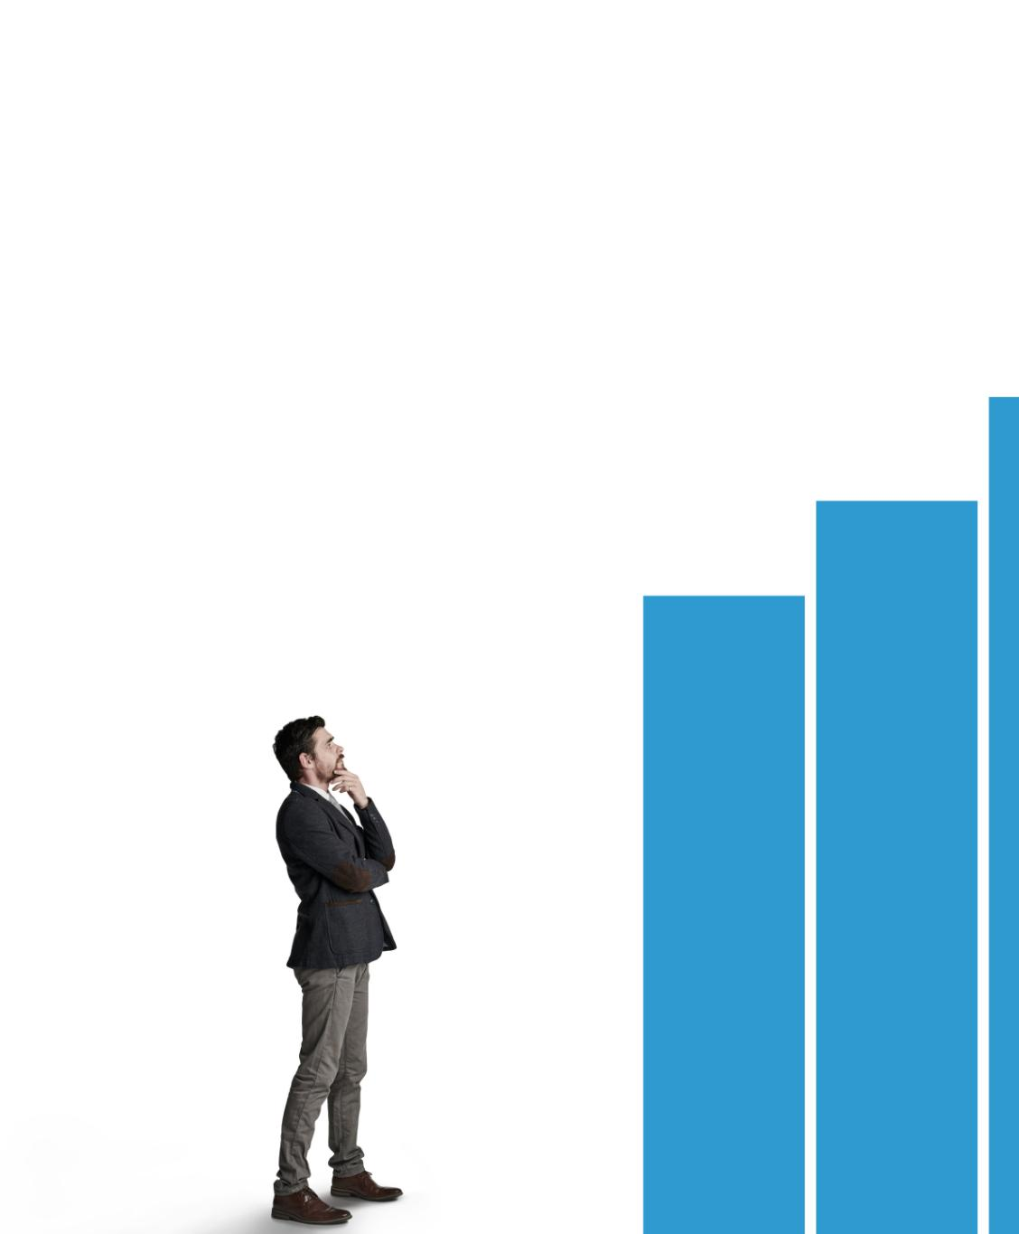
Conclusion
Valuable Insights
Sentiment analysis offers critical insights into customer feedback, helping businesses understand satisfaction levels more effectively.
Effective Techniques
Our project demonstrates the effective application of various machine learning techniques for sentiment analysis.
Future Improvements
This work sets the stage for future enhancements in sentiment analysis, aiming for even more precise results.
Notes:
In conclusion, sentiment analysis using machine learning provides valuable insights into customer feedback and satisfaction. Our project highlights the effective application of various techniques and sets the stage for future improvements.

